Slide 1

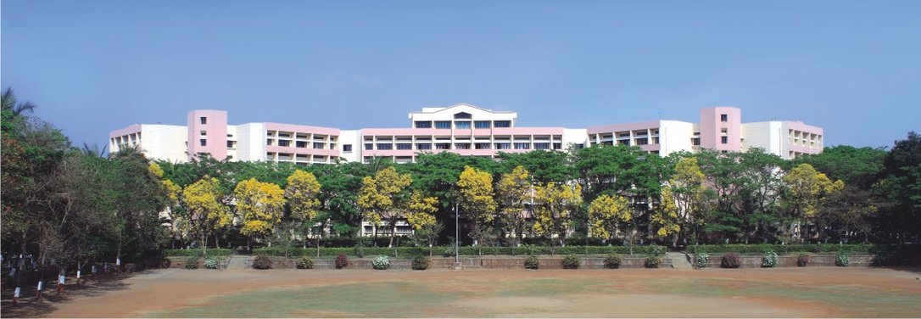

Industrial Internship Presentation
Submitted by:
Chetan Hatkar
TE A 23
Yash Jadhav
TE A 26
Submitted to:
Prof. Manodnya Shitole
Notes:
1

Slide 2
TRAINING DETAILS
Start Date : 1 February 2023
End Date : 28 April 2023
Mode of Training : Offline
Training Company : Nutshell Infosoft PVT. LTD.
3

Slide 3
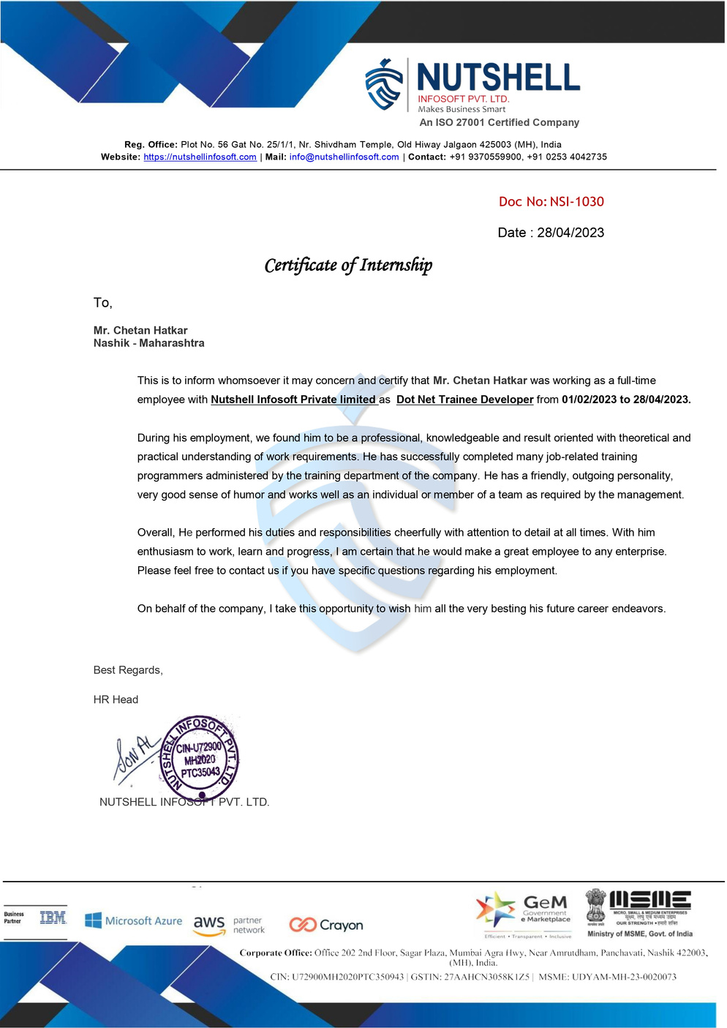
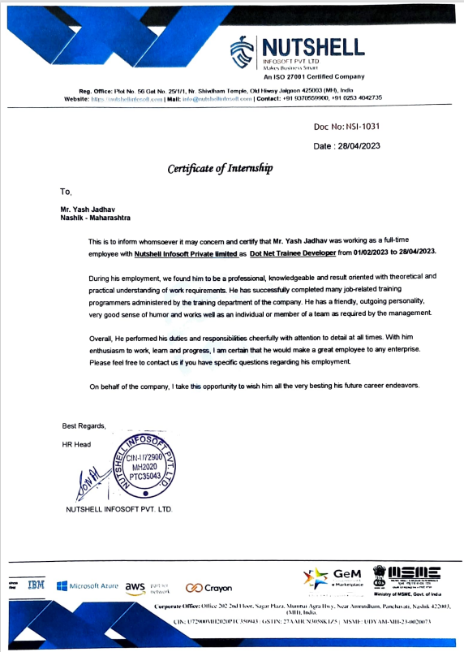
CERTIFICATE
4

Slide 4
INTRODUCTION TO ASP.NET
ASP.NET is a web development framework by Microsoft that offers cross-platform compatibility and allows server-side programming with languages like C# and .NET. Its features include code reusability, seamless integration with Microsoft technologies like SQL Server and Azure, MVC architecture, extensibility with custom modules and handlers, built-in security features, scalability, and rapid development tools like Entity Framework and Web API. ASP.NET is open-source and actively maintained by the community.
Code reusability: ASP.NET allows developers to create reusable components and libraries using class libraries.
Easy integration with other Microsoft technologies: ASP.NET seamlessly integrates with other Microsoft technologies such as SQL Server, Azure, and Visual Studio.
MVC architecture: ASP.NET uses the Model-View-Controller (MVC) pattern, which separates application logic, user interface, and data models.
5

Slide 5
INTRODUCTION TO ASP.NET
Server-side programming: Developers can write server-side code using languages such as C# and +.NET.
Extensibility: Developers can extend the functionality of ASP.NET by creating custom modules and handlers.
Built-in security features: ASP.NET includes built-in security features such as authentication and authorization, which can be easily customized.
Scalability: ASP.NET can handle large amounts of traffic and can be easily scaled up or down depending on the needs of the application.
Open-source: ASP.NET is open-source and is actively maintained by Microsoft and the community.
5

Slide 6
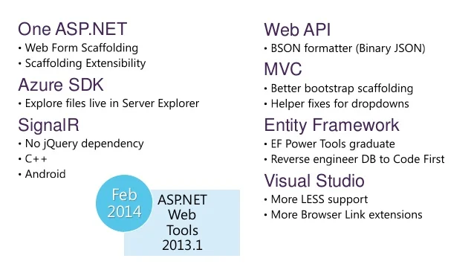
WEB DEVELOPMENT PROCESS USING ASP .NET
MVC .NET Framework Web Development Process:
Planning and Discovery
Design
Development
Testing
Deployment
Maintenance
12

Slide 7
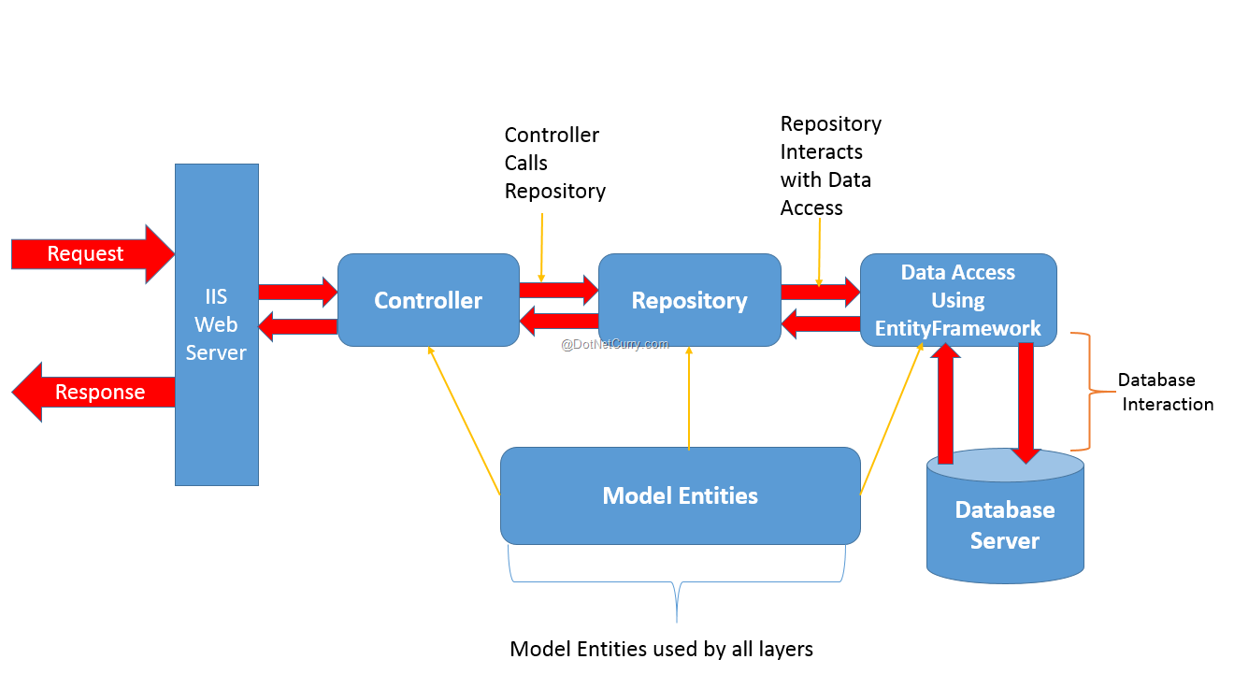
Architecture of Asp.net
7

Slide 8
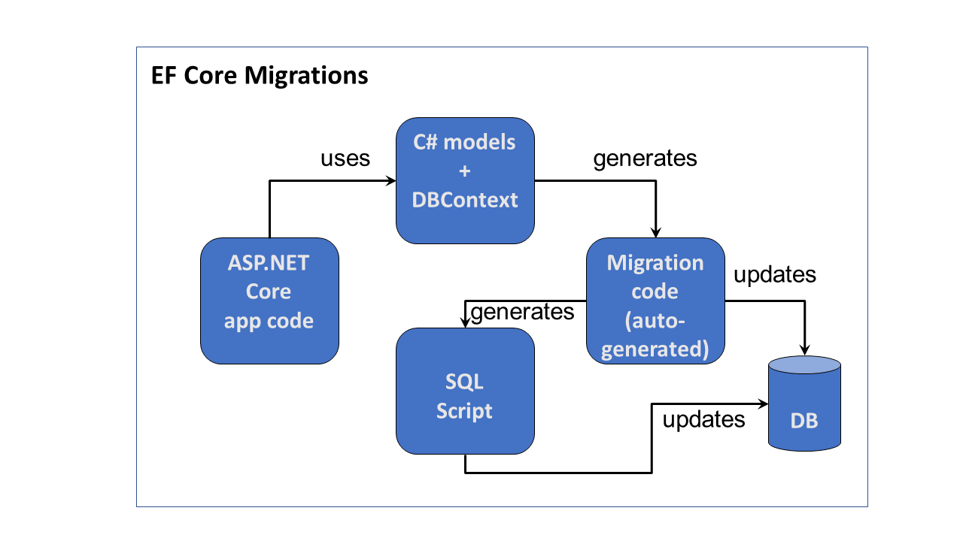
Migration in Asp.net and Blazor
7

Slide 9
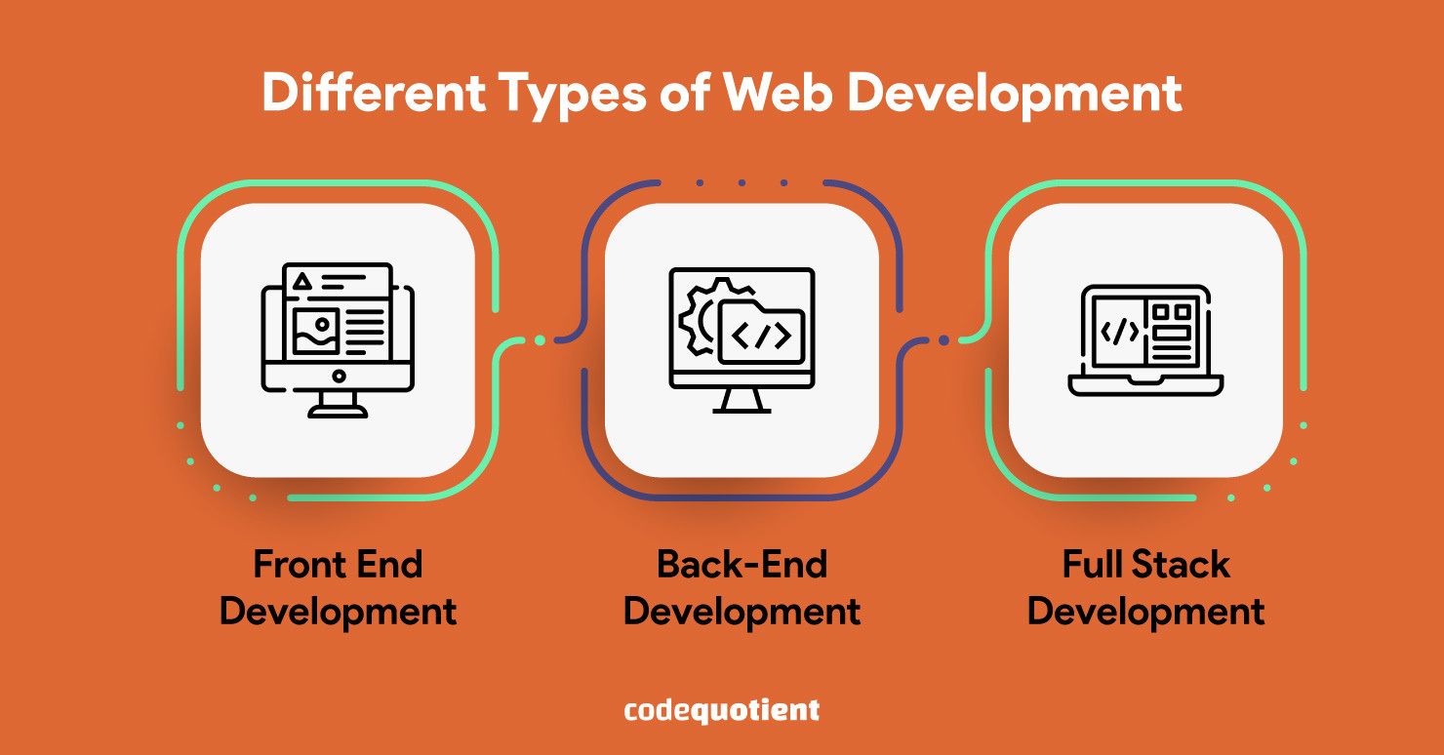
TYPES OF WEB DEVELOPMENT
7

Slide 10
FULL-STACK WEB DEVELOPMENT
Full-stack development involves working on both the front-end and back-end of a web application.
It requires knowledge of multiple programming languages, frameworks, and tools used in both front-end and back-end development.
Full-stack developers typically have a broad understanding of all aspects of web development and can work on a variety of projects.
They can design the user interface, create server-side functionality, and manage the deployment and maintenance of the application.
10

Slide 11
Algorithms Used
Algorithm that are used in our Projects.
1.Binary Search: This algorithm is commonly used for sorted databases and works by repeatedly dividing the search interval in half until the desired record is found. Binary search has a time complexity of O(log n) where n is the number of records in the database.
2. Hash Search: This algorithm uses a hash function to map the search key to an index in the database, making the search process very fast. Hash search has a time complexity of O(1), but it requires a well-designed hash function.
3. AES Algorithm: This algorithm ensures the security of the system by implementing measures such as data encryption, password policies, and access control.
4. Hash-based Message Authentication Code (HMAC) algorithm: The HMAC algorithm uses a cryptographic hash function to generate a message authentication code that can be used to verify the authenticity and integrity of a message. In .NET, the HMAC algorithm is implemented using the HMACSHA256 or HMACSHA512 classes. These classes provide a simple and secure way to create message authentication codes using a shared secret key.
14

Slide 12
PROJECT 1: Visitor Management System
Visitor Management System
This project involves the development of a Visitor Management System using .NET MVC. The system keeps records of visitors, including their arrival and departure times. In case of a power loss, a temporary item table is used to prevent the loss of data.
The MVC architecture separates the application into three components: the Model, which manages the data and business logic, the View, which handles the user interface, and the Controller, which manages user interactions and updates the model and view accordingly.
Overall, the Visitor Management System using .NET MVC provides an efficient and secure solution for managing visitor traffic in organizations, enhancing security, and improving the visitor experience.
13

Slide 13
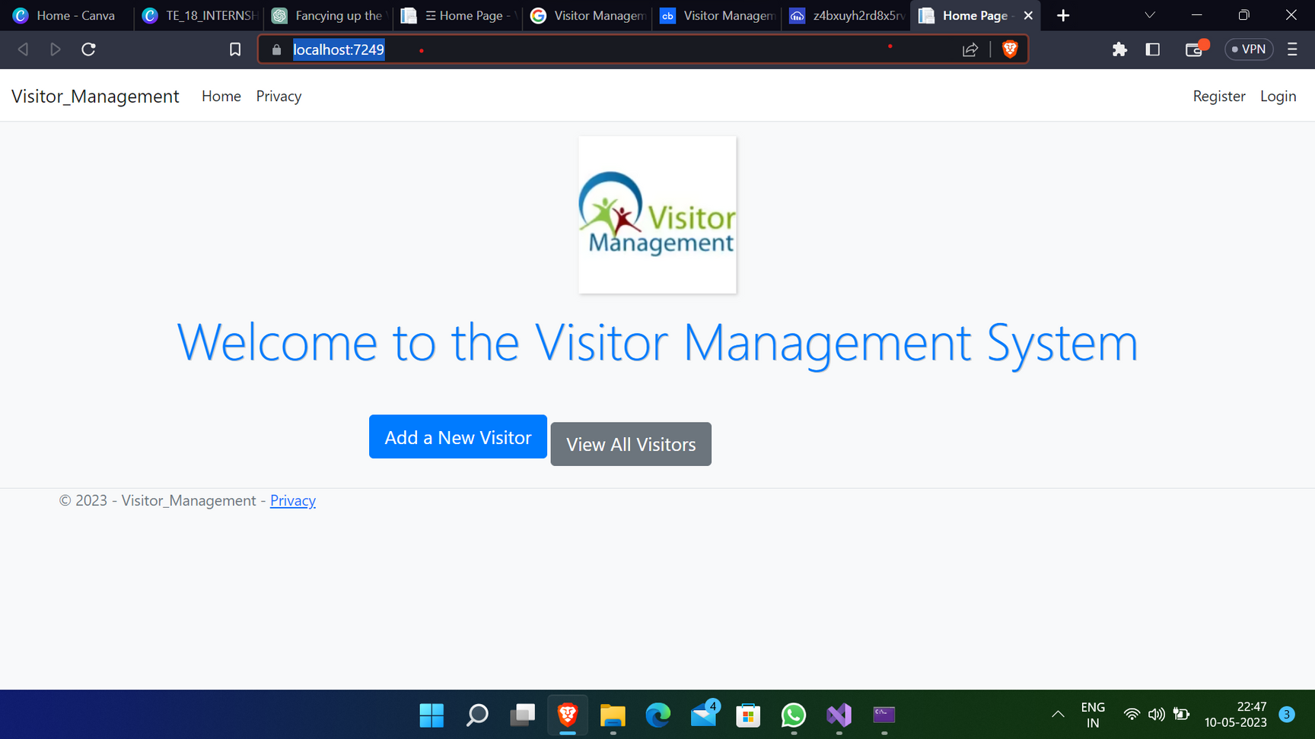
OUTPUT-HOME PAGE
19

Slide 14
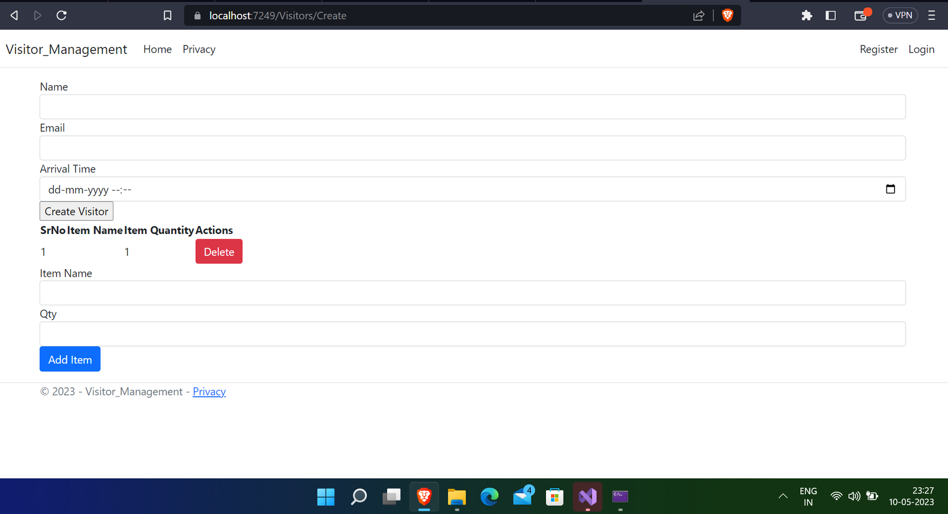
ADD NEW VISITOR
20

Slide 15
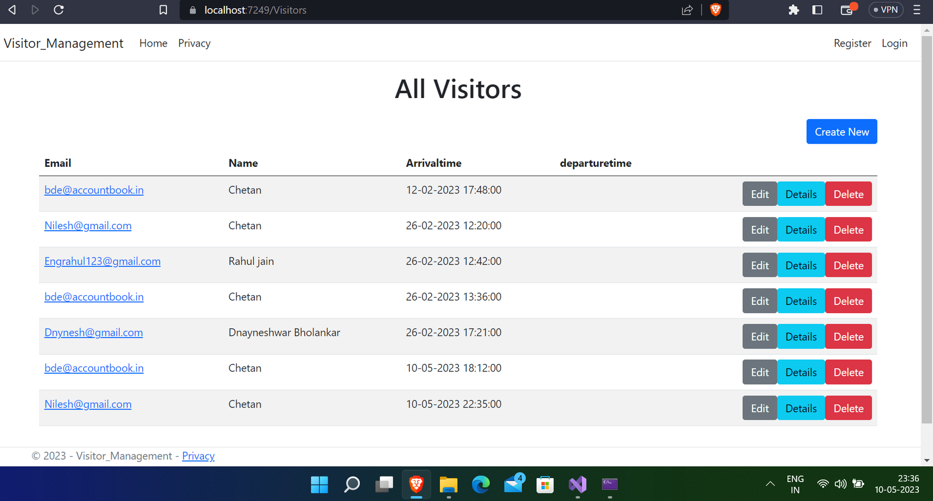
ALL VISITORS
21

Slide 16
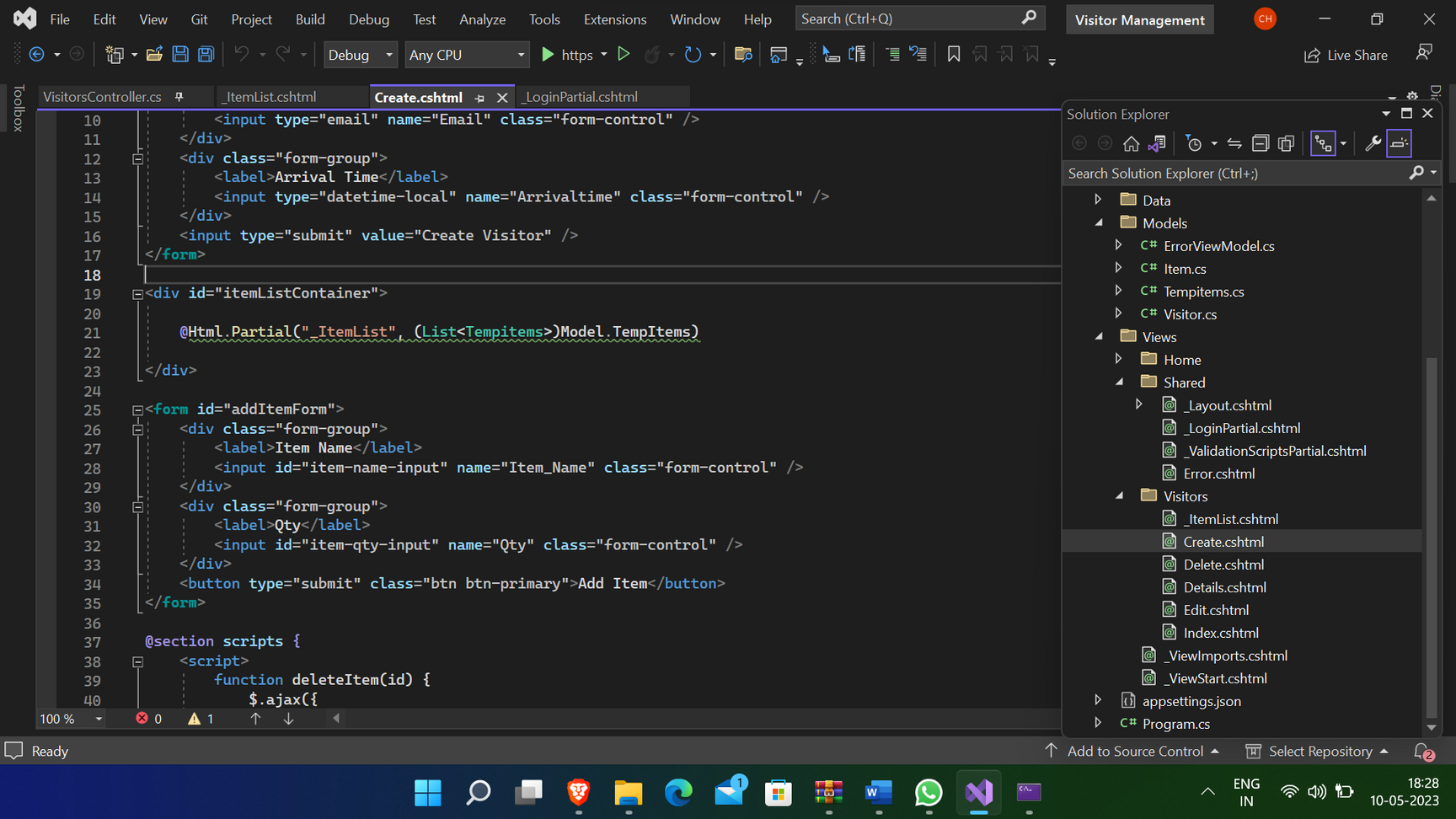
HOME OVERVIEW
16

Slide 17
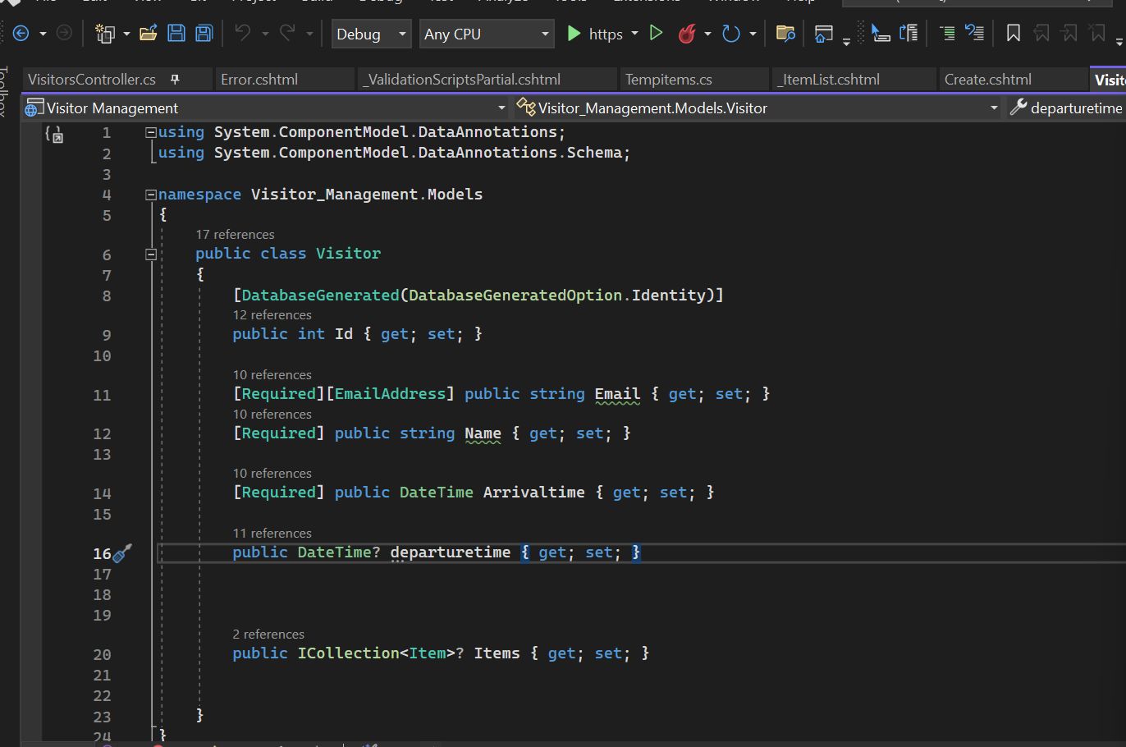
Model Class
17

Slide 18
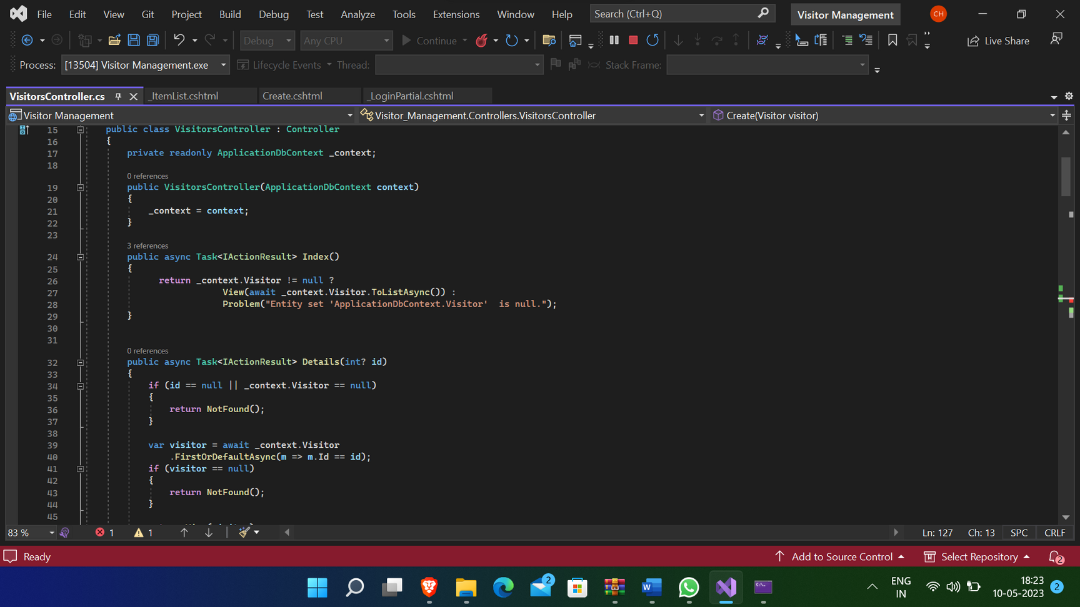
Controller
18

Slide 19
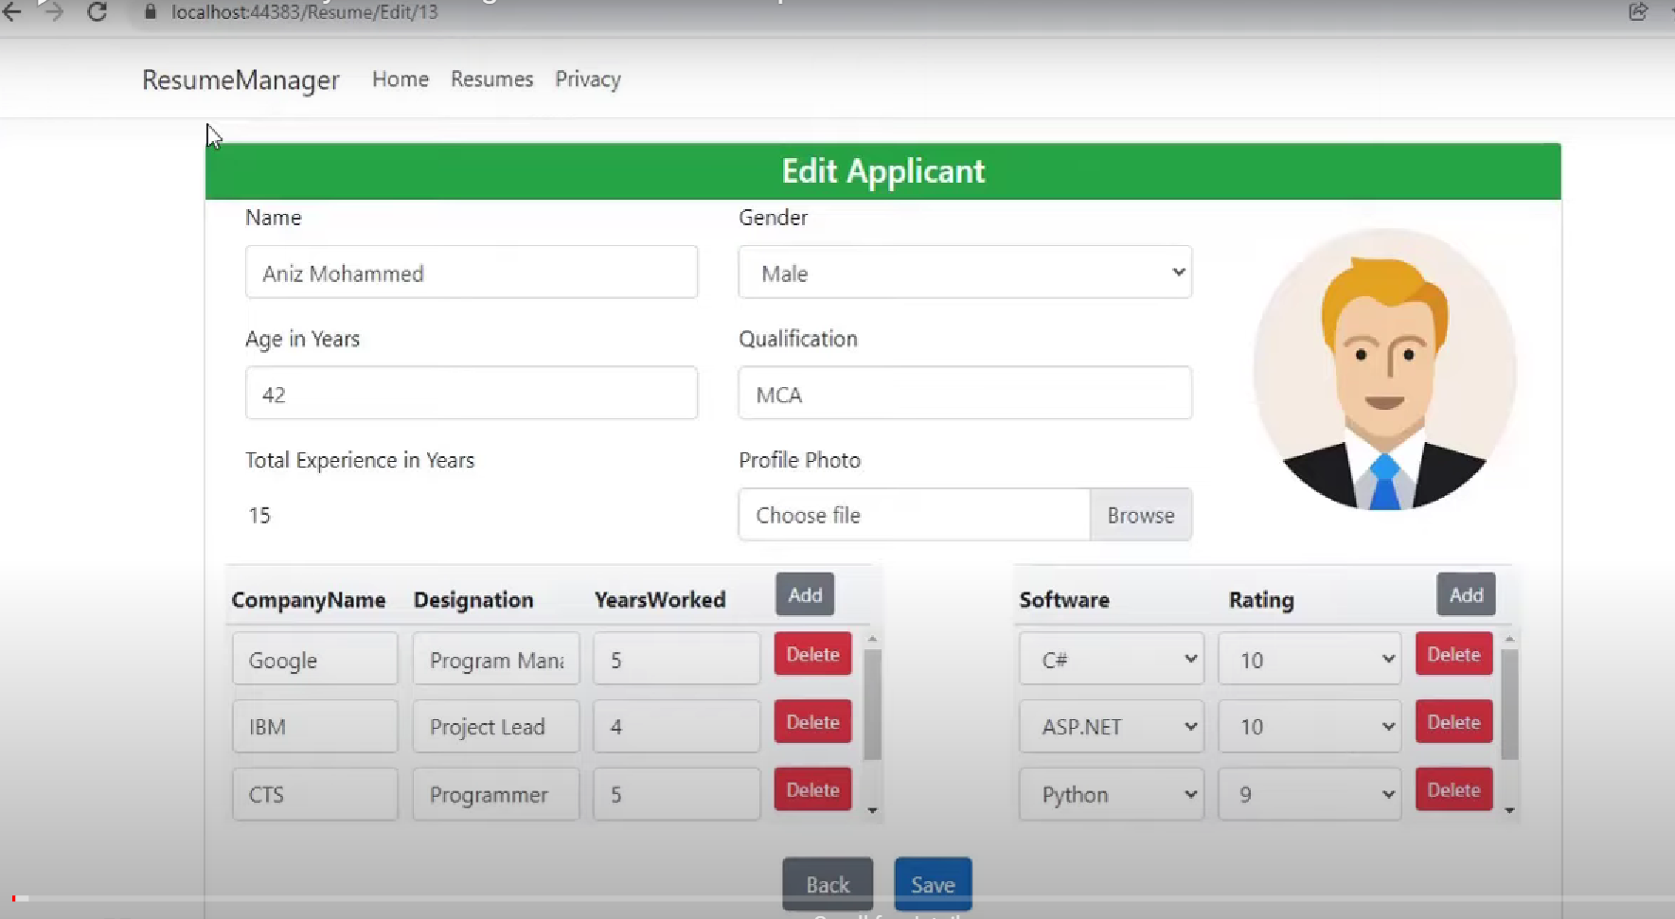
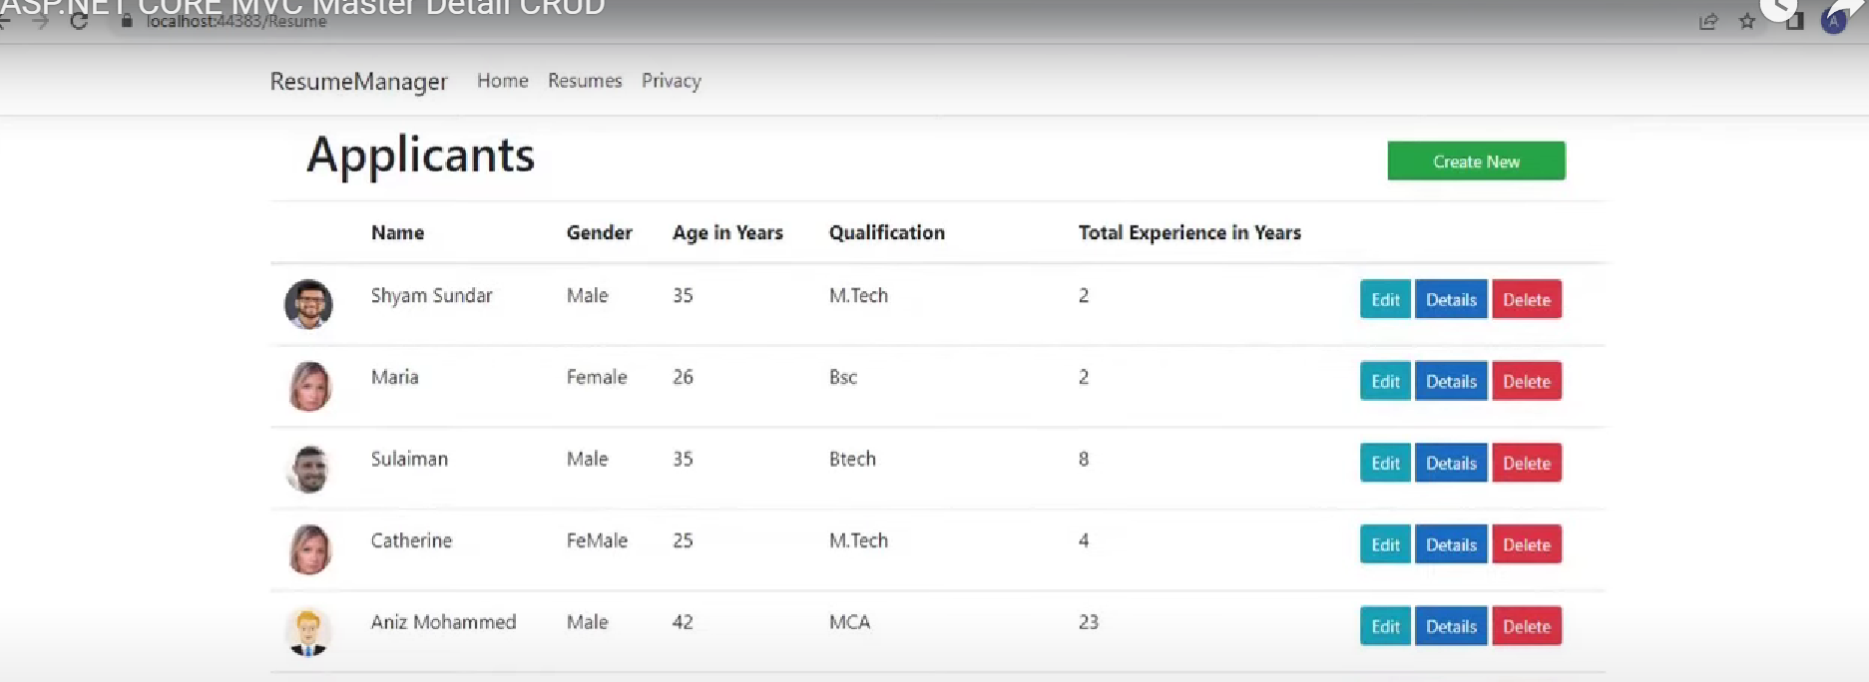
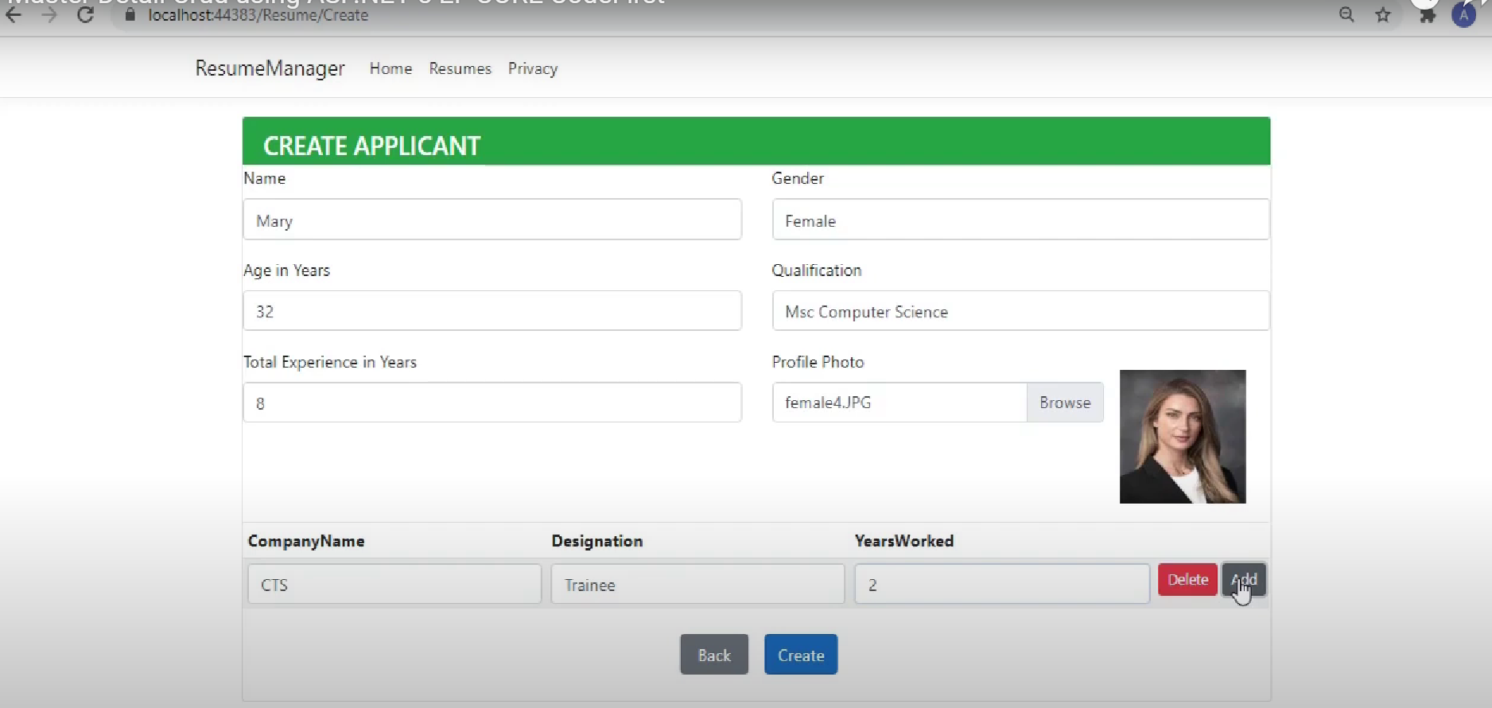
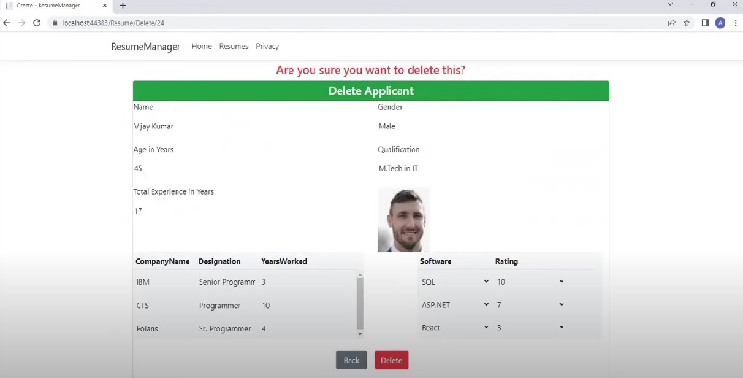
Project 1 b: Management System
19

Slide 20
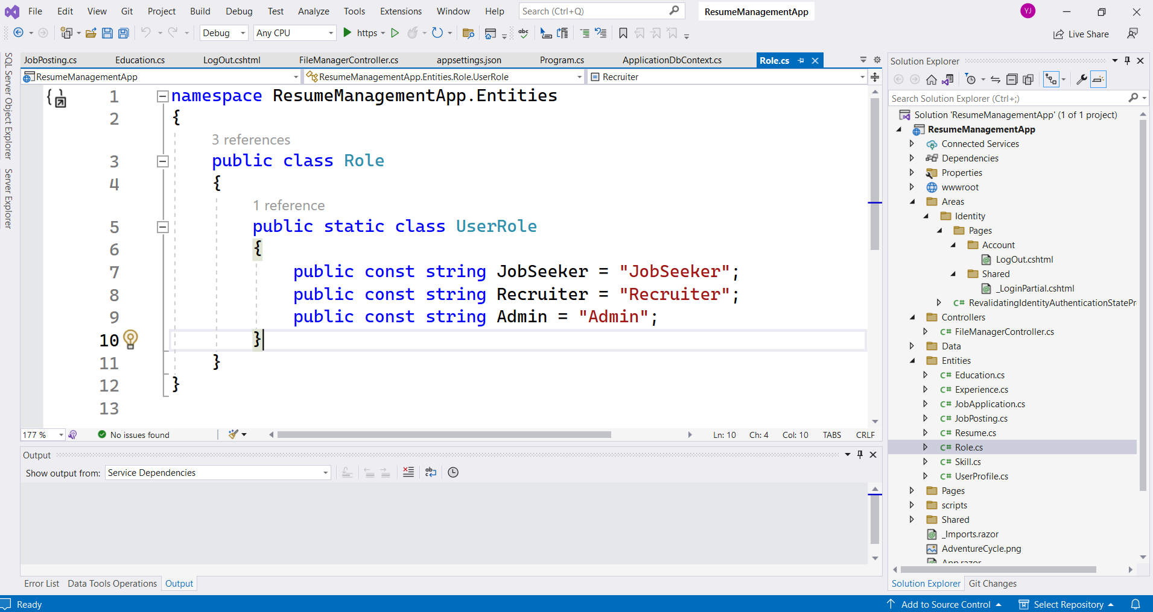
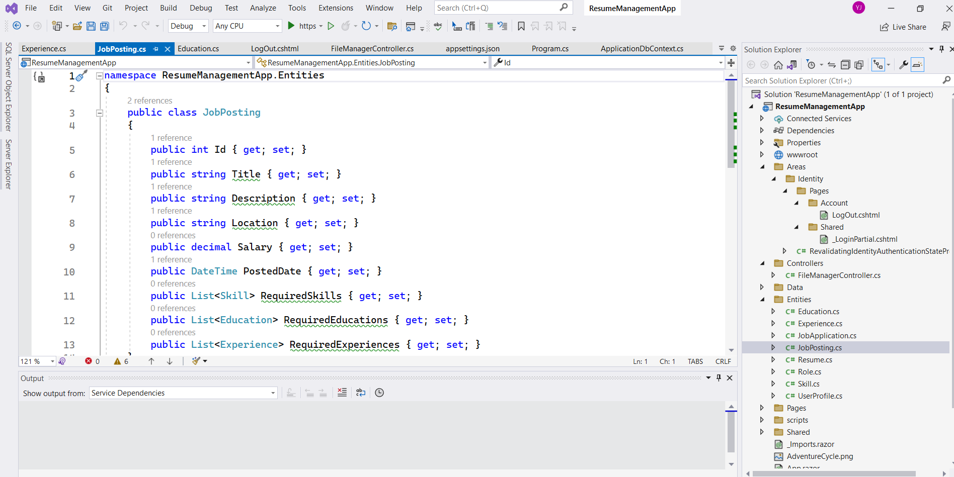
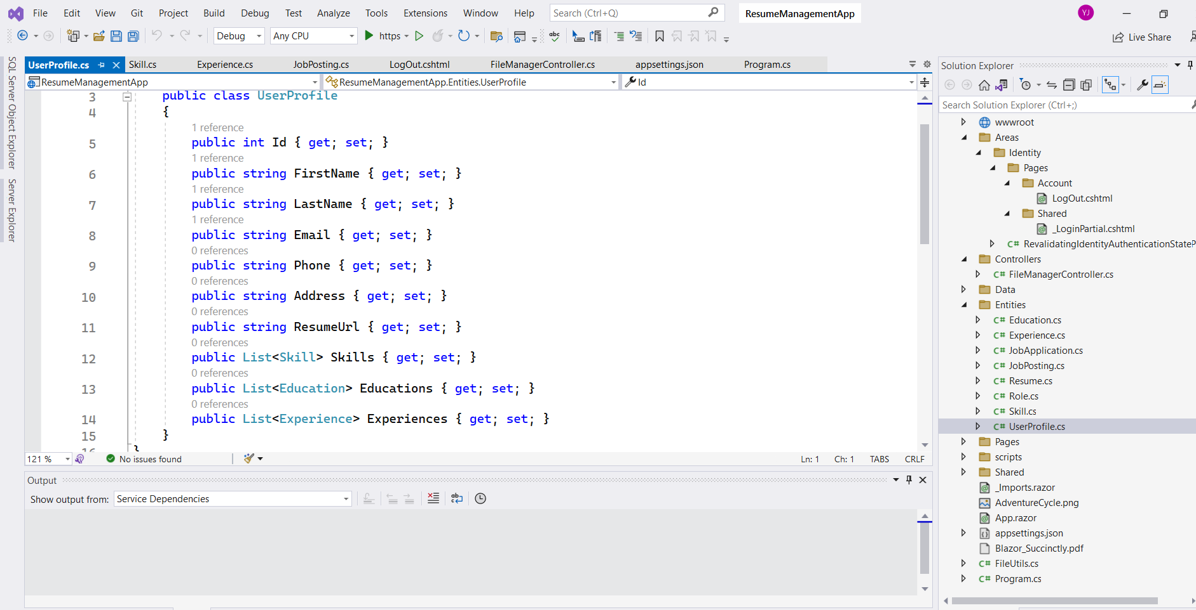
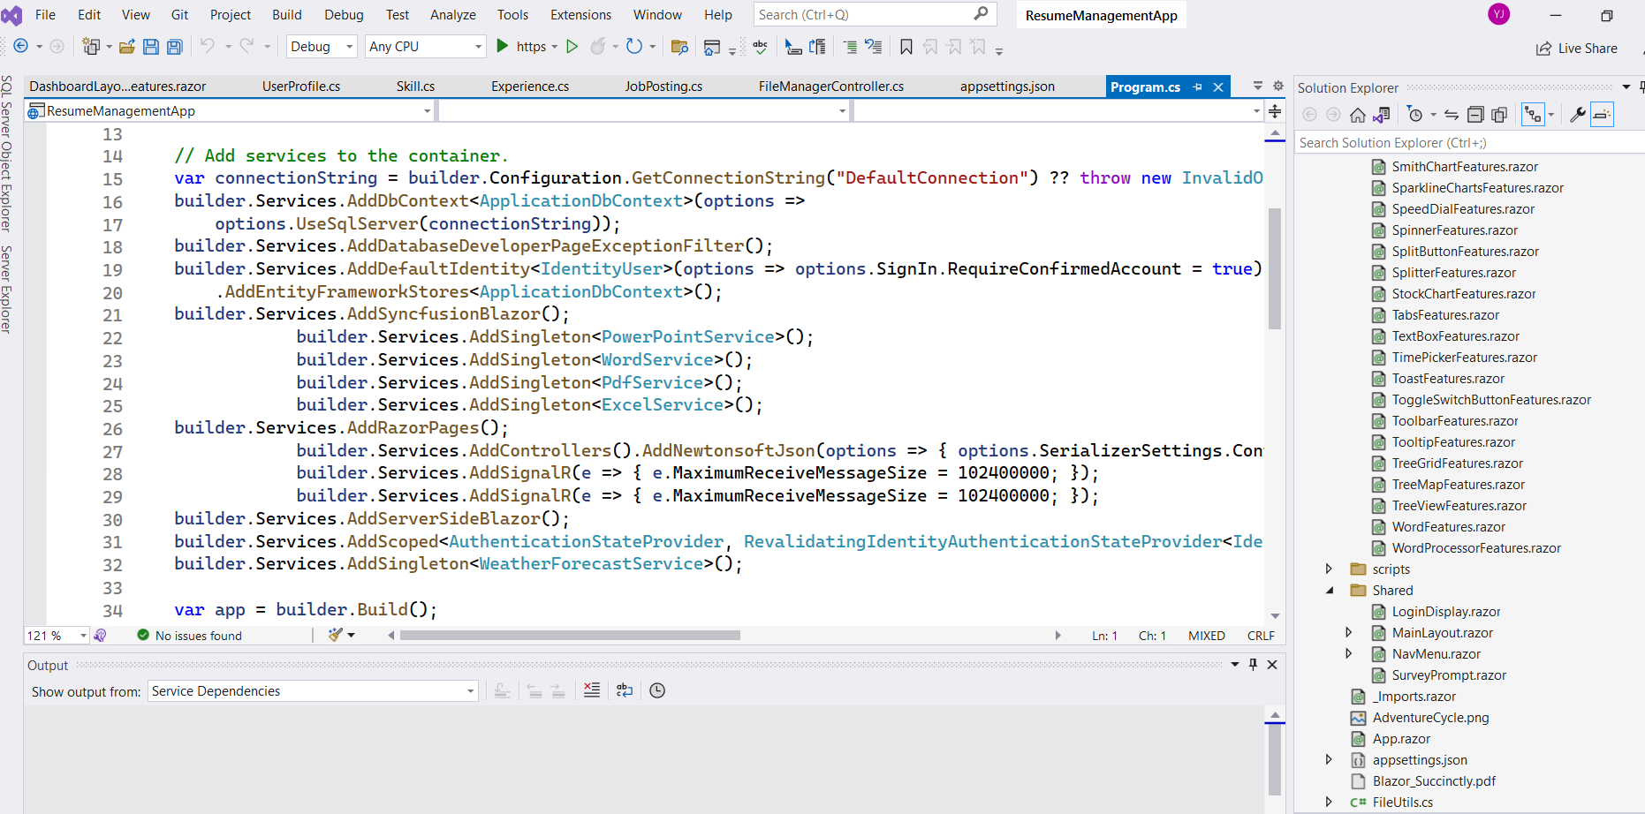
Project 1 b: Resume Management System
19

Slide 21
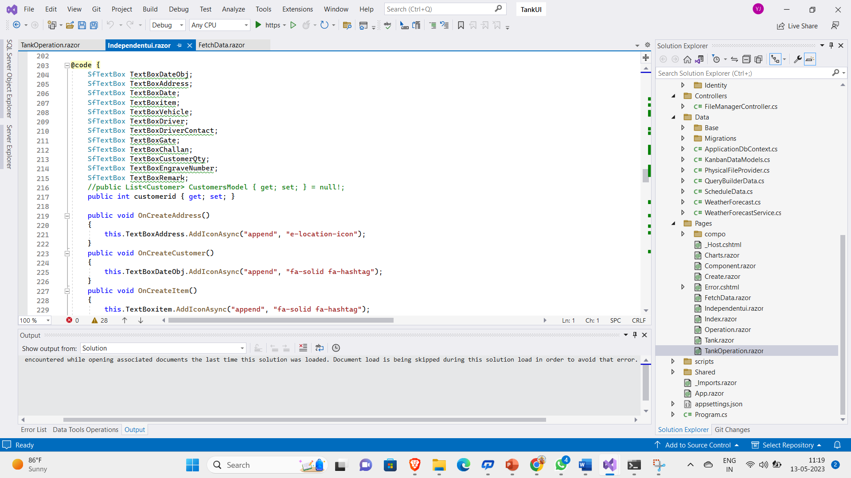
Project 2: Tank Management System (Blazor real world project)
19

Slide 22
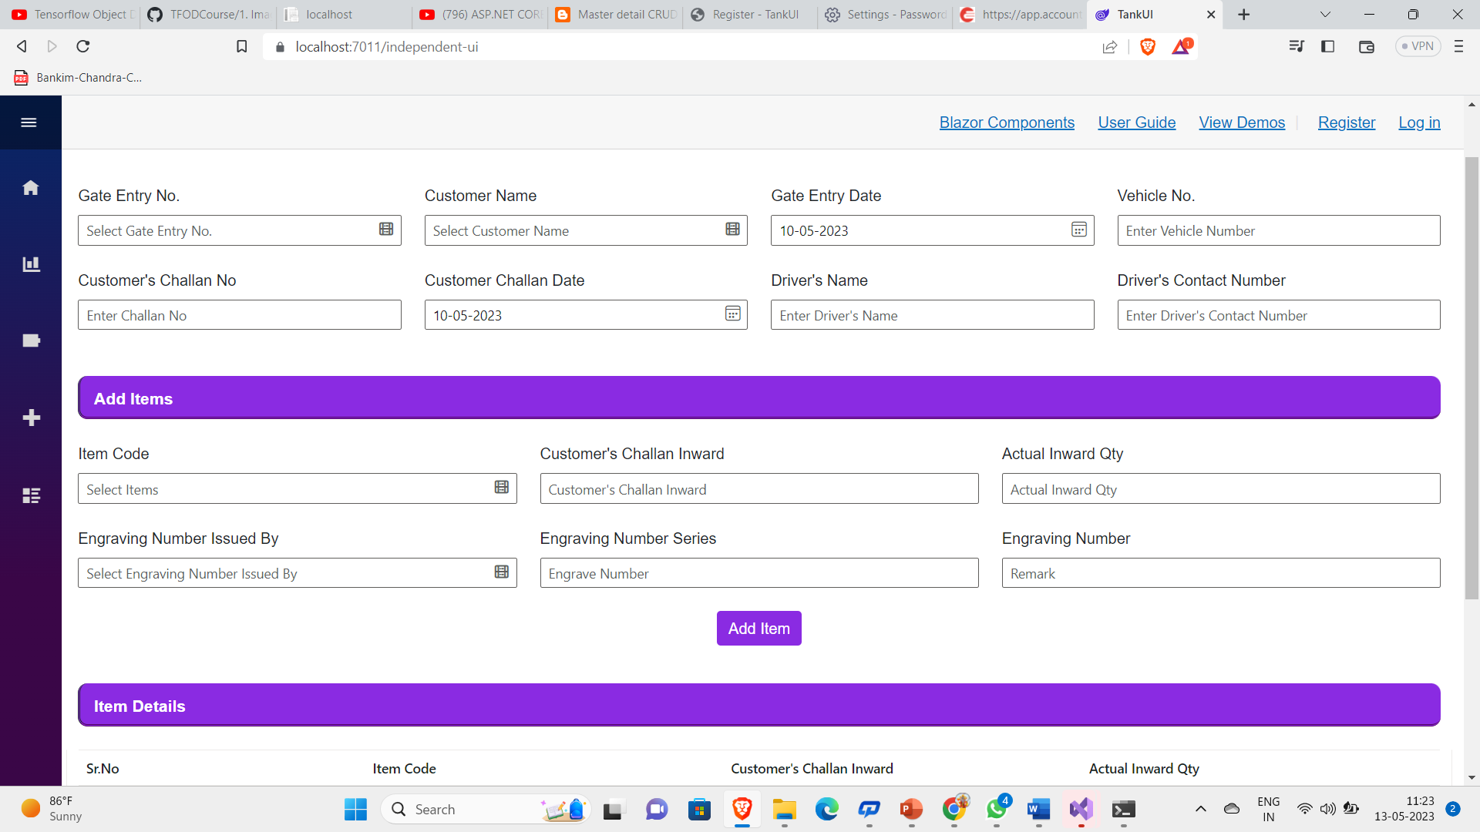
Project 2 Tank Sales Details
19

Slide 23
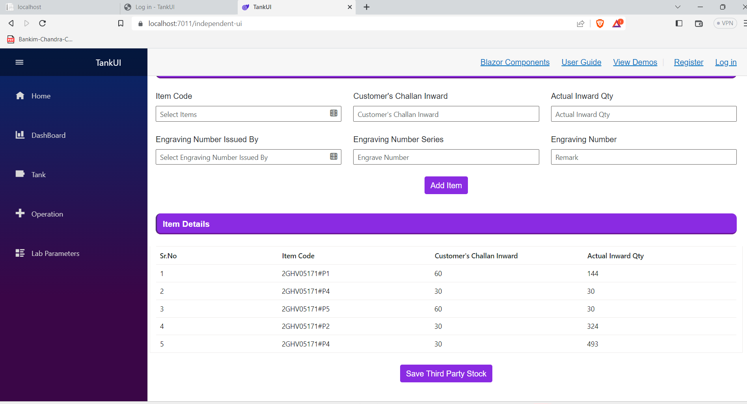
Project 2 Partial Table
19

Slide 24
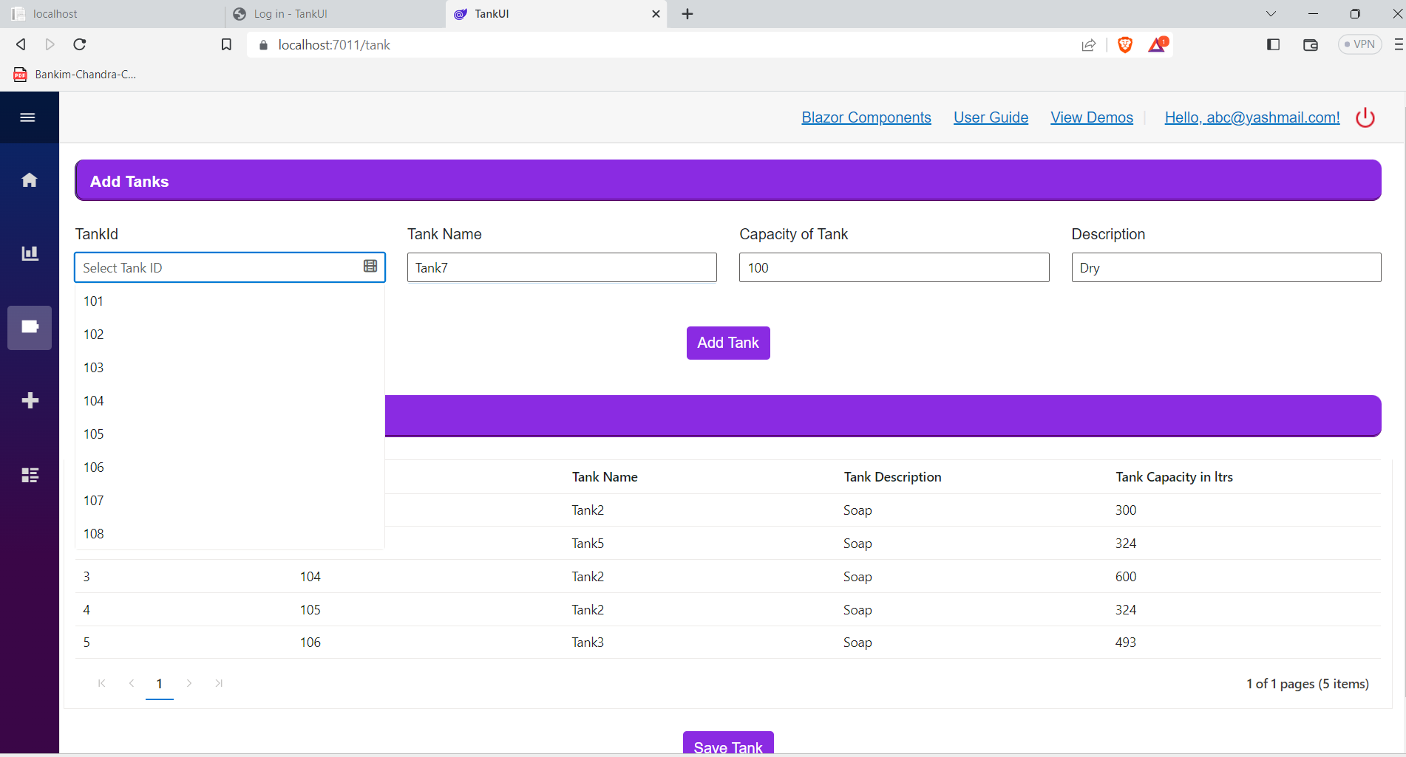
Project 2 Tank Creation Details
19

Slide 25
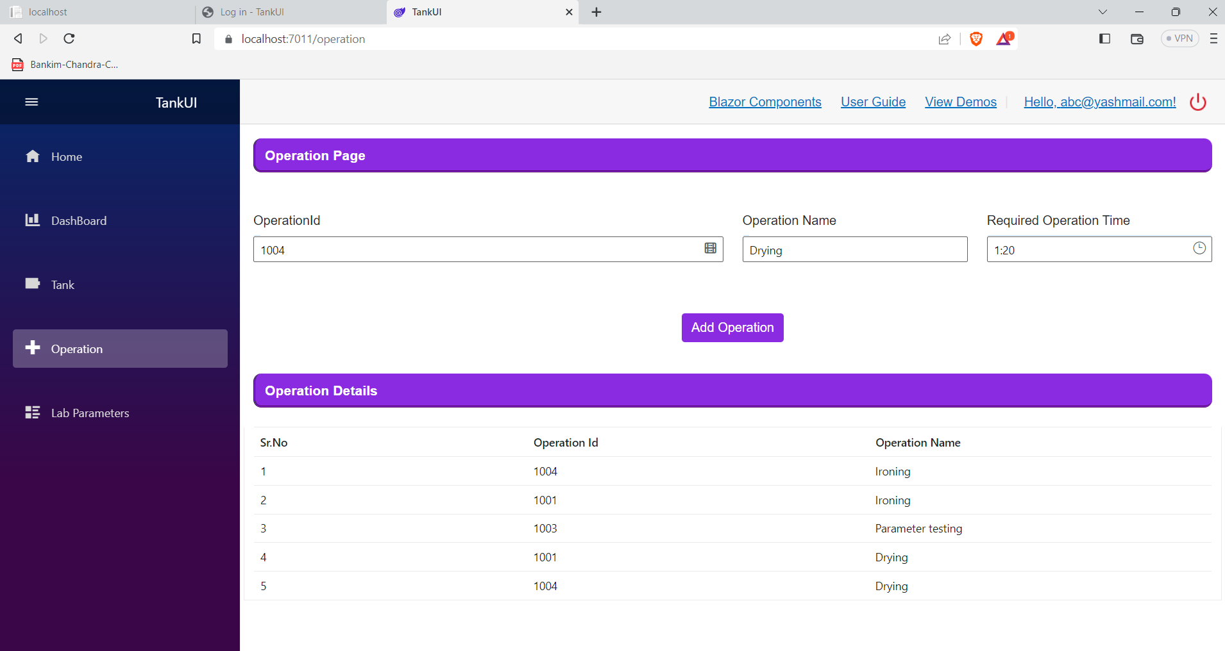
Project 2 Tank Operation Details
19

Slide 26
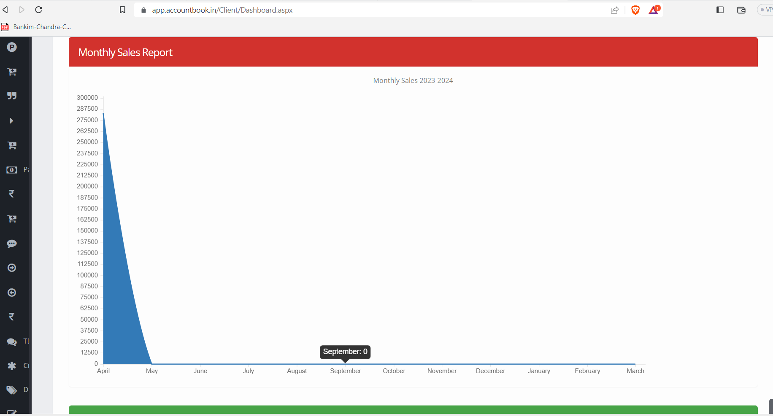
Project 2 Dashboard
19

Slide 27
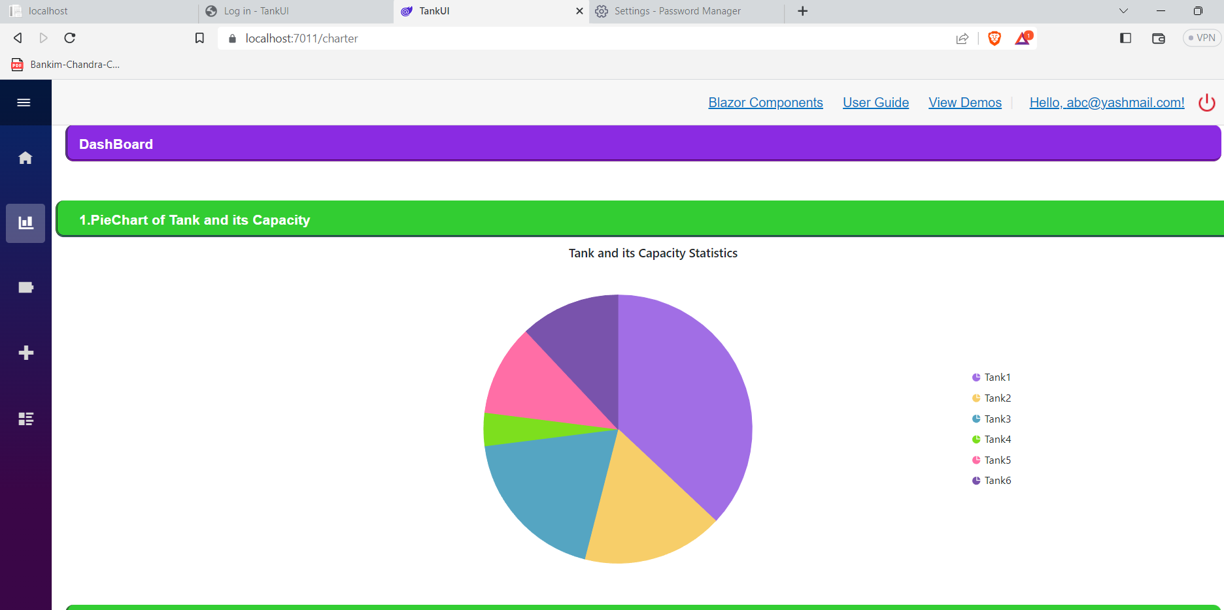
Project 2 Dashboard
19

Slide 28
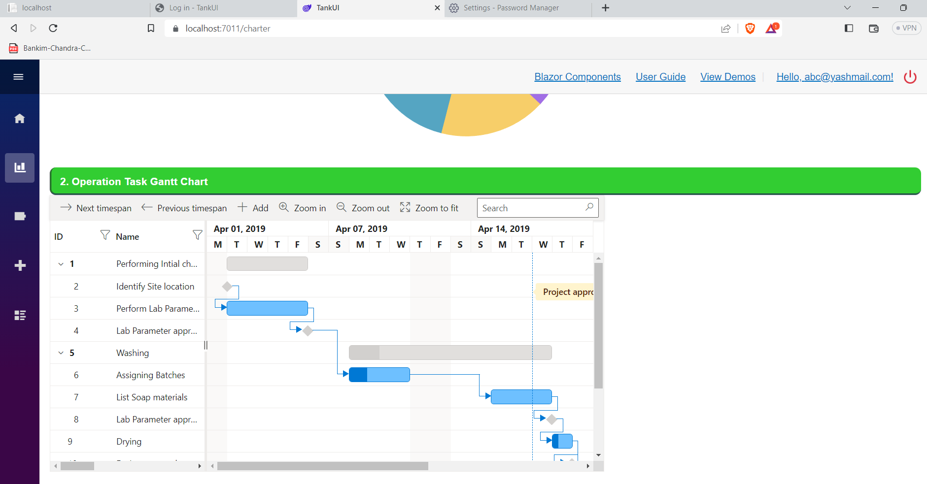
Project 2 Dashboard
19

Slide 29
CONCLUSION
During our Dot Net developer Internship, We gained valuable experience in web development and programming. We learned the importance of observation in identifying and solving problems, as well as the value of effective communication in technical discussions and working with team members.
Our project taught us patience, self-trust, and the ability to take initiative and solve problems. Additionally, our communication skills were strengthened through technical discussions and working with team members.
Overall, the skills and experiences We gained during our Internship will be incredibly useful for us as We continue our work in the field. We feel more confident in our abilities to face challenges and contribute to the development of innovative solutions.
24

Slide 30

THANK YOU !!
25

